Slide 1
BPMN 2.0 Fundamentals
ProcessMaker™ BPMN Designer

Slide 2
Basic BPMN concepts
What is BPMN?
Business Process Model and Notation (BPMN) is a standard for business process modeling, and provides a graphical notation for specifying business processes based on a flowcharting technique.
What is Business Process Modeling?
Business Process Modeling is the activity of representing processes of an enterprise, so that the current process may be analyzed and improved by other professionals.
Why use BPMN to design processes?
BPMN 2.0 is official way to design and share processes between almost all BPMS in the market. BPMN is an OMG Standard.

Slide 3
BPMN 2.0 Diagrams
BPMN can represent Business Models by 4 kinds of diagrams:
Process Diagrams
Represents regular flow between tasks, events and decision points to complete a process in the company.
Collaboration Diagrams
Represents message flows or communication routes between process or entities like customers or partners.
Conversation Diagrams
Represent groups of messages called “communications” and its relation between process and participants.
Choreography Diagrams
Represent participant interaction between task and users or resources and the messages result of this interaction.
Note: PM BPMN Designer supports Process and Collaboration diagram modeling.

Slide 4
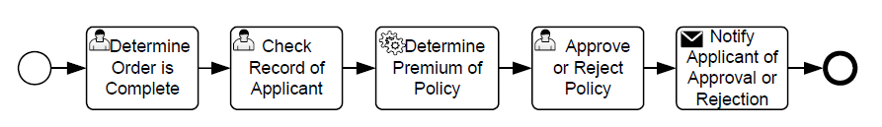
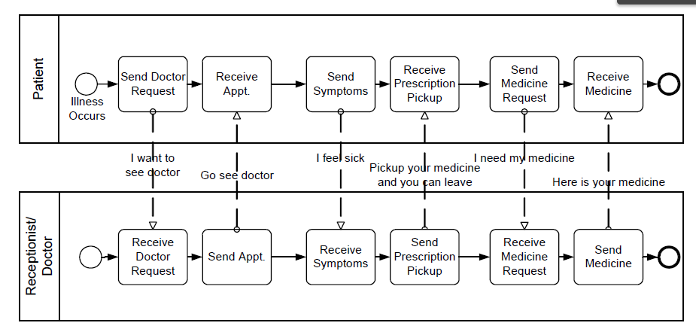
Types of BPMN Diagrams
Process Diagram
Collaboration Diagram

Slide 5
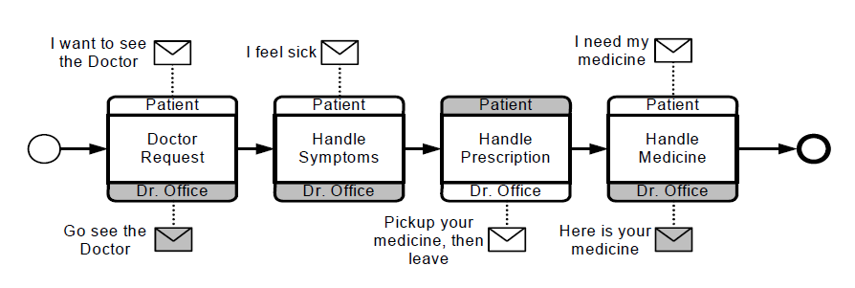
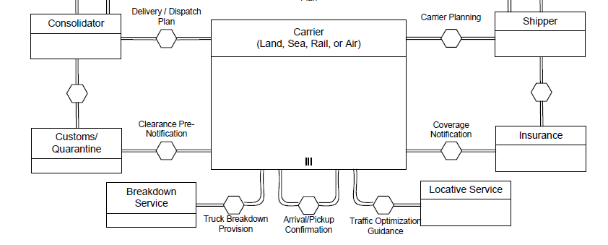
Types of BPMN Diagrams (cont.)
Choreography Diagram
Conversation Diagram

Slide 6
ProcessMaker™ BPMN Project
BPMN Project
Process # 1
Flow Objects
Data References
Connection Objects
Process # 2
Diagram # 1
Participants
Data Objects
Diagram # 2

Slide 7
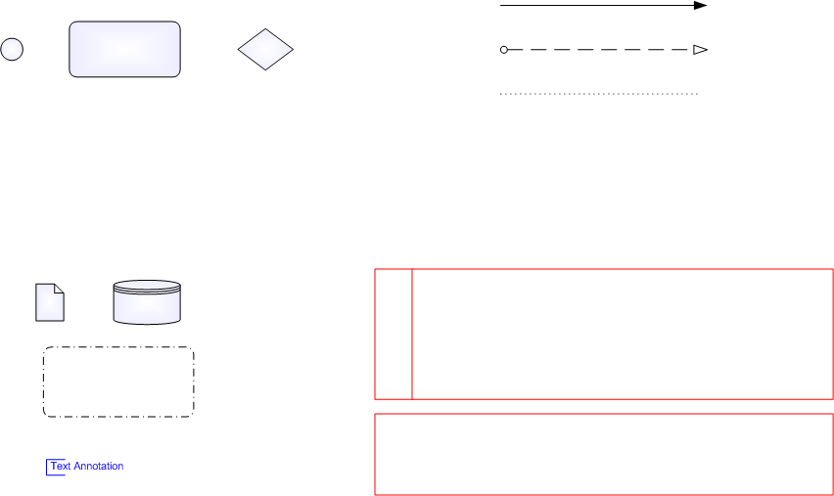
Core BPMN Design Elements
Flow Objects
Connecting Objects
SequenceFlow
MessageFlow
Association
Event
Activity
Gateway
Data Objects & Artifacts
Swimlanes
DataObject
DataStore
Pool
Group
Lane

Slide 8

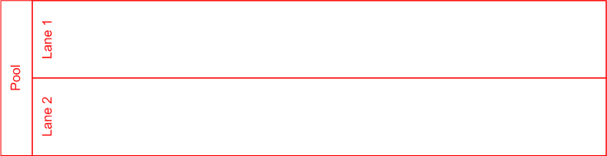
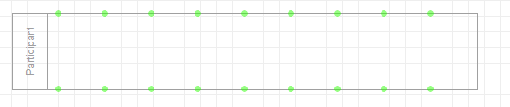

Swimlanes
Pool or Laneset is an element
representing a process into
an organization or company.
Lane is a representation of an
area or department of the
company. Some times can
represent a role into a process
scope.
Participant or Empty Pool is a
representation of a process or
entity that does not have any
action within the process.

Slide 9


Events
An Event is something that “happens” during the course
of a Process or a Choreography. An Event affects the
flow of the model and usually have a cause (Trigger) or
an impact (Result).
Event graphical representation is a circle.
There’s 3 types of events: Start Events, Intermediate
Events and End Event.
Intermediate Events can be used in regular process
diagrams and can be used as Boundary Events attached
to an activity.
Start Events and Intermediate Events can be Interrupting and
Non-interrupting.

Slide 10
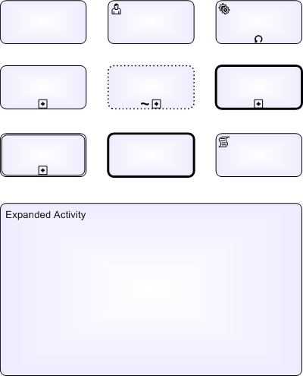
Activities
Activity is a generic term for work that
company performs in a Process. An Activity
Can be atomic or non-atomic.
The type of activities that are part of the process are: Task and Sub-Process.
A task can be differenced by markers that represent its type or associated resource.
Sub-Process can be Collapsed or Expanded, and can be differenced by the kind of elements that join in: Sub-process, Transactions, Event Sub Process and Call Activities.

Slide 11
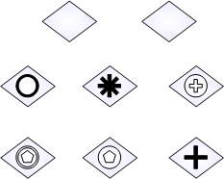
Gateways
A Gateway is used to control the divergence and convergence of sequence flows in a Process or in a choreography.
Gateway will determine branching, forking, merging or joining.
There’s 7 kinds of gateways differed by its internal marker: Exclusive, Inclusive, Parallel, Complex, Event-based, Parallel Event-based and Exclusive Event-based.
=

Slide 12
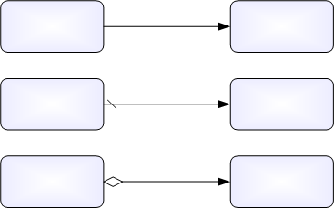
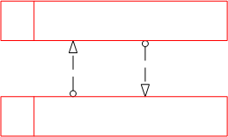
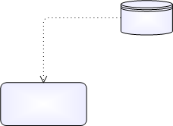

Connection Objects
There’s 6 types or connection objects. All
of them are represented for a line.
Sequence Flow can be Normal, Default
and Conditional, and always have direction,
source and target.
Message Flows are a type of connection object
that is used to represent collaboration between
two process.
Data Association is a line between a Data Object and
An element.
Normal
Default
Conditional
Message
Association
Data Association

Slide 13
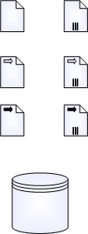
Data Objects
BPMN 2.0 can represent Data in two ways: Data Stores and Data Objects.
A Data Store provides a mechanism for Activities to retrieve or update stored information that will persist beyond the scope of the Process. The same Data Store can be visualized, through a Data Store Reference, in one or more places in the Process.
Data Objects provide information about what Activities require to be performed and/or what they produce, Data Objects can represent a singular object or a collection of objects.
Data Objects can be separated in Data Input and Data Output only considering direction of the information.

Slide 14

Artifacts
BPMN 2.0 considers 2 types of artifacts: Groups and
Text Annotations.
A Group is a grouping of graphical elements that
are within the same Category. This type of grouping does not affect the Sequence Flows within the Group. The Category name appears on the diagram as the group label. Categories can be used for documentation or analysis purposes. Groups are one way in which Categories of objects can be visually displayed on the diagram.
Text Annotations are a mechanism for a modeler to
provide additional text information for the reader of
a BPMN Diagram.

Slide 15
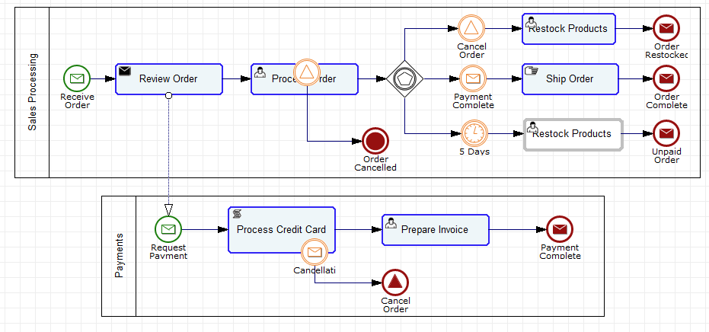
Process Diagram Sample

Slide 16
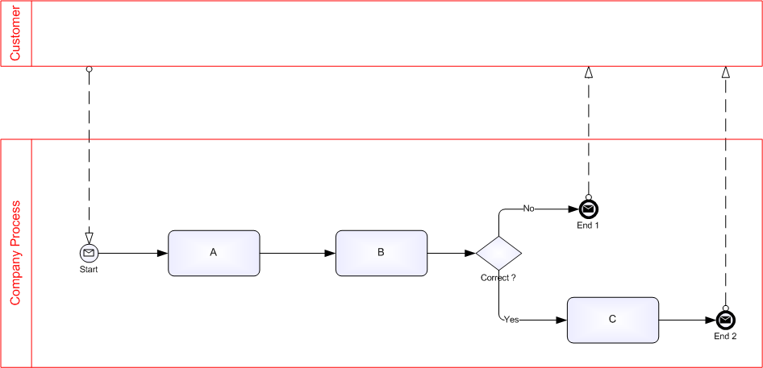
Collaboration
Into collaboration diagrams there’s a main concept to consider: “A PARTICIPANT”.
BPMN considers a participant an entity or process involved into a collaborative relation .
Participants

Slide 17
Useful References
Object Management Group/Business Process Management Initiative
www.bpmn.org
Documents Associated with Business Process Model and
Notation (BPMN) Version 2.0
http://www.omg.org/spec/BPMN/2.0/
Enrique Ponce de Leon (qennix)
Development Team Leader – Colosa Inc.
enrique@colosa.com – iam@qennix.com
August, 2011

